Slide 1


wids@ubc presents
DSCI100
Study Social
welcome! get ready to crush your midterm!

Slide 2
Welcome!

Slide 3




Find these slides and a practice worksheet here:
https://tinyurl.com/dscistudy100
Upload to your own JuypterHub!

Slide 4
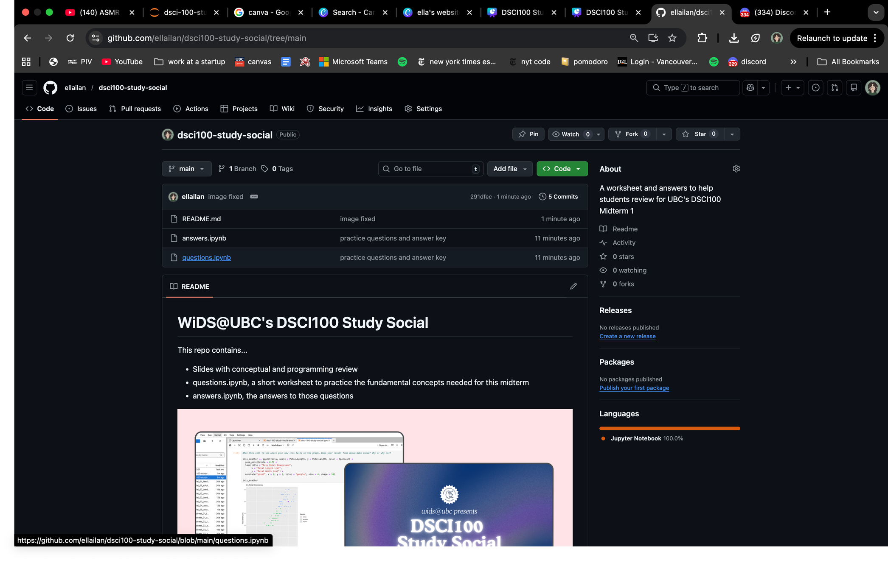
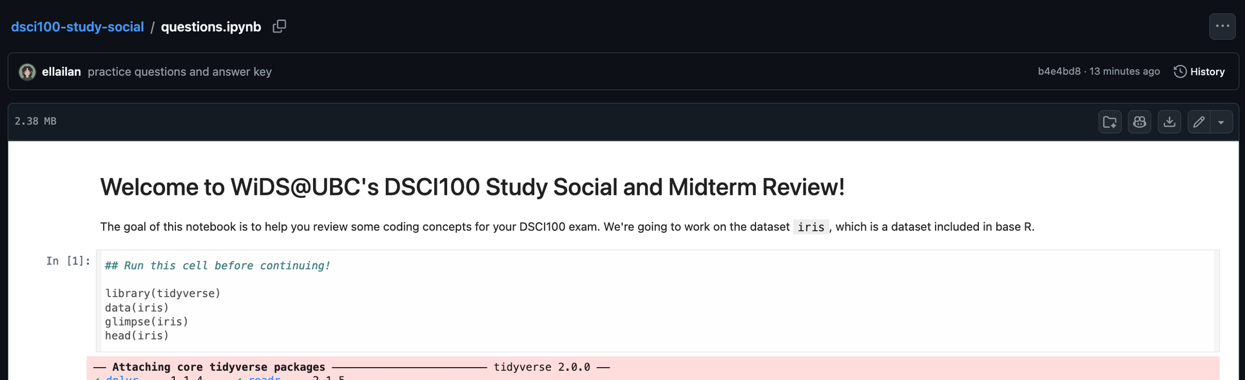


Slide 5
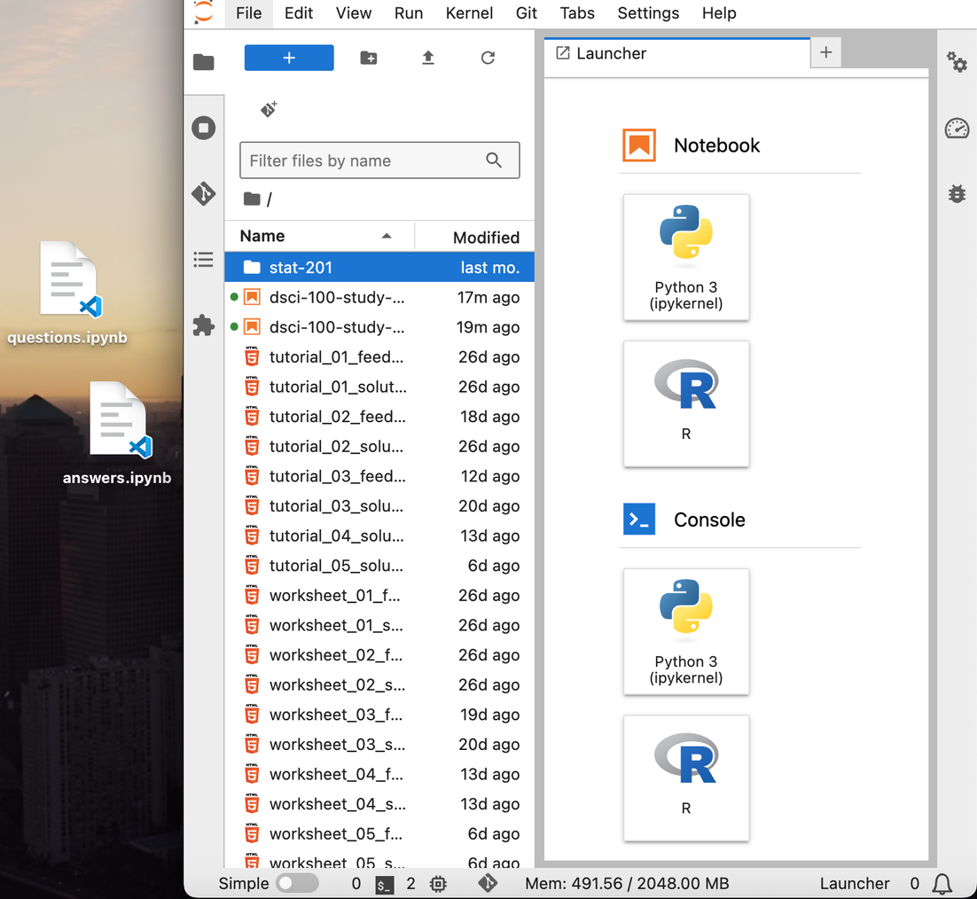


Slide 6
Code & Concepts

Slide 7
Code & Concepts

Slide 8
Let’s strategize!
Data Science 100 is an introductory data science course.
Its exams focus heavily on understanding the theory behind the code. We need to know the why, not just the how.
This is especially relavant because of the format of the exam. You do not have access to a code editor. Don’t stress about that too hard. This is to your advantage!

Slide 9
Using the formula sheet
Coding questions on this exam, if/when they appear, are almost always fill-in-the-blank.
You will be granted access to a formula sheet that is super useful and comprehensive.
Code-based questions on this exam are auto-graded. Even if you are somewhat sure of your answers, I would highly reccomend copy and pasting from the formula sheet to avoid typos and errors.

Slide 10
multiple choice? fill-in-the-blank? short answer?
Command+F!

Slide 11
Anatomy of a function
We can generally define a function as something that..
gets information,
does something with that information,
and returns something new.

Slide 12

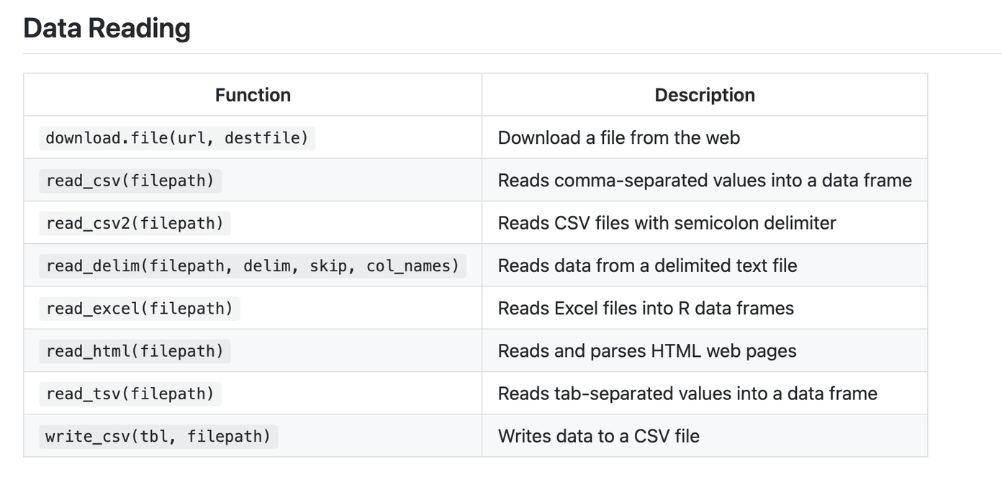


The formula sheet and functions
function description; what the function does and returns
function name; how to call the function
arguments; what information the function gets

Slide 13

library(tidyverse)

Slide 14
Reading Data
read_csv(), read_csv2(), read_tsv(); read_delim() for custom delimiters
Can read from file paths or URLs! Parse as string!!!!!!!!
Useful arguments:
col_names = FALSE
skip = n
Read Excel files with library(readxl) and read_excel()

Slide 15
Filter, Select
filter() vs select()
filter() → chooses rows
select() → chooses columns
Common filter operators. Take a moment to find in your formula sheet!
==, !=
>, <, >=, <=
| (OR)
%in% (matches any value in a vector)

Slide 16
Filter, Select
Let’s look at the anatomy of the filter() and select() functions
What do they get?
Filter and select both recieve a dataframe, and some additional information.
What do they do?
Filter and select are used to specify data of interest.
Select chooses individual columns, while filter chooses rows that match a condition.
What do they return?
They both return a dataframe that is smaller than the original dataframe.

Slide 17
Arrange, Slice
arrange() and slice()
arrange() orders rows by column values
slice() selects rows by row number or range
slice(1)
slice(5)
slice(1:5)
Used together to get the top of a dataset arranged by some value (e.g. arrange by highest exam scores, and return the top scoring student.)
Both of these functions get a dataframe, and return a dataframe.

Slide 18
Map
What does it get?
map() gets a dataframe and a desired function
What does it do?
Map() applies a function to many columns
Use:
map_df() → rows
What does it return?
map() always returns a LIST, use above f(x) to get a tibble

Slide 19
Mutate
mutate() creates new columns using existing columns.
e.g. mutate(area = width*height)
mutate() gets a dataframe, it does whatever you tell it to, and it returns the whole dataframe you gave it, plus the new column.

Slide 20
group_by() and summarize()
Last semester, lots of students found these two functions quite confusing!
These two functions are used together in this course. But I think they’re easier to understand when we look at their “anatomy” seperately.

Slide 21
group_by()
What does it get?
group_by() recieves a dataframe, and a column that specifies what categories you would like to group your data by.
What does it do?
group_by() puts your data into different groups using metadata.
What do they return?
group_by() returns what seems to be the exact same dataframe as what it was given. To the naked eye, group_by() does nothing on its own.

Slide 22

Visualizing group_by()
species
height
giraffe
500 cm
ant
0.02 cm
ant
0.01 cm
giraffe
400 cm
giraffe
300 cm

Slide 23
Visualizing group_by()
species
height
giraffe
500 cm
ant
0.02 cm
ant
0.01 cm
giraffe
400 cm
giraffe
300 cm

Slide 24
summarize()
What does it get?
Summarize recieves a dataframe. It can be grouped or ungrouped.
What does it do?
summarize() will calculate summary statistics, as specified.
e.g. summarize(mean_height = mean(height))
If the dataframe given to summarize() is grouped, the function will run once per group. Otherwise, it will run on the whole dataframe
What does it return?
summarize() creates an entirely new dataframe! It returns only the summaries it was asked for.

Slide 25
Visualizing summarize()
species
height
giraffe
500 cm
ant
0.02 cm
ant
0.01 cm
giraffe
400 cm
giraffe
300 cm
animal_stats ← animals |> summarize(mean_height = mean(height))
mean_height
240.006

Slide 26
Visualizing group_by() |> summarize()
species
height
giraffe
500 cm
ant
0.02 cm
ant
0.01 cm
giraffe
400 cm
giraffe
300 cm
animal_stats ← animals |>
group_by(species) |>
summarize(mean_height = mean(height))

Slide 27
Visualizing group_by() |> summarize()
species
height
giraffe
500 cm
ant
0.02 cm
animal_stats ← animals |>
group_by(species) |>
summarize(mean_height = mean(height))
ant
0.01 cm
giraffe
400 cm
giraffe
300 cm
species
mean_height
giraffe
400 cm
ant
0.015 cm

Slide 28
Questions?

Slide 29
Code & Concepts

Slide 30
Types of Questions
Descriptive
Summarized characteristics, without interpretation; supplies facts
Exploratory
Is there a trend? Used to propose hypothesis
Predictive
Predicts measurements or labels
Inferential
Looks for trends and quantifies how applicable this trend is the wider population
Causal
Will changing one factor change another?
Mechanistic
How does a relationship happen?

Slide 31
Types of Answers
Summarization: Aggregated values (means, medians, counts)
Visualization: Graphical representations to explore patterns
Classification: Predicting categories (labels)
Regression: Predicting numerical values
Clustering: Finding unknown subgroups
Estimation: Inferring population values from a sample

Slide 32



Understanding Dataframes
species
height
Tidy Data Principles
giraffe
500 cm
Rows = observations
Columns = variables
Values = individual measurements
ant
0.02 cm
ant
0.01 cm
giraffe
400 cm
giraffe
300 cm

Slide 33
Why tidy data?
Consistent structure
Works with tidyverse functions
Easier to understand and analyze

Slide 34
File Paths
Absolute paths
Start with /
Machine-specific
Error-prone, long, and not portable
Relative paths (preferred)
Relative to current working directory
Use . (current) and .. (parent)
Portable and shorter, use these instead!

Slide 35
Data Visualization
Choosing a Visualization
Scatter plot → relationship between two quantitative variables
Line plot → trends over ordered variable (e.g., time)
Bar plot → compare amounts
Histogram → distribution of one quantitative variable
Avoid...
Pie charts
3D plots
Tables for numerical comparison

Slide 36
Data Visualization
Refining Visualizations
Clear labels and legends
Colorblind-friendly colors
Avoid overplotting
Minimize visual noise
Don’t manipulate axes to exaggerate differences
Redundancy helps understanding!

Slide 37
Data Visualization
Explaining Visualizations
Set context and scope
State the question
Answer using the visualization
Describe:
Trends
Spread and center
Relationships
Group differences
End with a clear takeaway

Slide 38
Using databases, the tbl() function, and SQL
SQLite Databases
Lightweight, file-based (.db)
Efficient for large datasets
PostgreSQL Databases
Client–server database system
Used over networks
Same workflow as SQLite, but uses RPostgres
Requires more connection arguments

Slide 39
Using databases, the tbl() function, and SQL
Steps
Connect using dbConnect()
List tables with dbListTables()
Use tbl() to query data
Bring data into R with collect()
Key idea
tbl() translates R code into associated SQL (standard query language) queries
Data stays in database until collect() function is ran

Slide 40
Why Use Databases?
Handle large datasets efficiently
Data integrity and access control
Multiple users can work simultaneously
Built-in backups and security

Slide 41
Classification and K-NN
Recall our types of Data Science questions. K-Nearest Neighbours is a classification problem, for which we ask predictive questions.
How does it work?
Our goal is to predict a categorical label, using some features to assign a class
We compute distances to training points, where the distance we are considering = straight-line
We sort all the points around us by distance
We select the K-nearest neighbors
We predict the class of our new observation using majority vote!

Slide 42
Classification and K-NN
KNN with library(tidymodels)
Load tidymodels
Select predictors
Create model with nearest_neighbor()
Fit model with fit()
Predict with predict()
Use your reference sheet!

Slide 43
K-NN Centering & Scaling (Standardization)
What Problem Are We Fixing?
Variables can be on very different scales
e.g., age (0–100) vs income (0–100,000)
Distance-based models (like KNN) treat larger numbers as more important
This can distort similarity calculations
After centering and scaling, all variables contribute fairly to distance calculations and therefore fairly to our classification

Slide 44
Version Control
Why do we need Version Control?
Version control is a system for:
Tracking changes to files over time
Recording who changed what and when
Allowing multiple people to work on the same project safely
Git & GitHub
Git: tracks changes locally
GitHub: a website that hosts repositories online
Repositories
Local repository: your working copy
Remote repository: shared online copy

Slide 45
The Four Git Commands You Need!
Stage / Add:
Selects which specific file changes will be included in the next commit. It prepares your changes to be saved.
Commit:
Creates a saved snapshot of your project at a specific point in time. This lets you go back to previous versions if something breaks.
Push:
Sends your committed changes from your computer to a remote repository like GitHub. This updates the shared version of the project.
Pull:
Downloads changes from the remote repository to your local computer

Slide 46
Merge Conflicts....
Merge
Combines changes from two branches
Merge Conflict
Happens when the same code is edited differently
Git cannot automatically combine
To Resolve
Open conflicted file
Edit and remove conflict markers
Stage the file
Commit the fix
Push if needed

Slide 47
What can you do tonight?
Follow along with my Juypter notebook for some light practice on data summarizing, visualization, and K-NN Classificaiton! Answers are also included in the repository.
Ask our lovely executives all your pressing questions.
Get a yummy dinner and go to bed early tonight!

Slide 48
Good Luck!

